Slide 1
CDF Water Projects
Caroline Kemunto Bosire

Slide 2
Motivation
Water is life yet it has been classified as a scarce resource in Kenya(Momanyi,2005). Over 50% of Kenyans do not have access to water. The water scarcity level is projected to increase per year by 2030 due to population growth(DI,2018).
Large populations living in informal settlements within the towns and cities have no access to safe water. In rural areas, there are large disparities between geographic areas where in North Eastern and Eastern Provinces
Despite CDF funds being allocated to resolve the water scarcity issue, the situation has not improved over the years.

Slide 3
Dataset(s)
Frequency : 5311 Number of water projects
Mean of the total amount spent on the water project : 7969641
Number of years analyzed: 7
Minimum number of projects per county :10
Maximum number of projects per county : 488
Maximum population per county : 3257627
Minimum population per county : 146160

Slide 4
Research Question(s)
What are the factors that influence the establishment of water projects in Kenya?
Does CDF funds allocation influence the number of water projects per county?
Does population influence establishment of the water projects?
Does agriculture influence the number of water projects per county?
Does Arid and Semi land(ASAL) county classification influence the number of water projects Kenya?

Slide 5
Methodology
Descriptive statistics was used to analyze data . Regression analysis was used to determine
the link between the dependent and independent variables.
Dependent Variable
Water project establishment
Independent variables
Population density
CDF funds allocation
Agriculture
Arid and Semi Arid Land Classification
Data cleaning using Pandas
Data Analysis through linear regression and descriptive statistics
Data Visualization using Matplot Lib and QGIS for spatial data

Slide 6
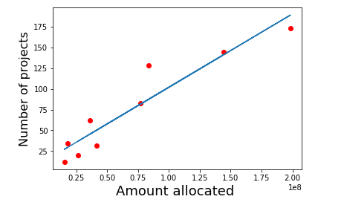
Water project and CDF expenditure
Does CDF funds allocation influence the number of water projects per county?
The counties that allocate more funds on the water project were able to establish more water projects.

Slide 7
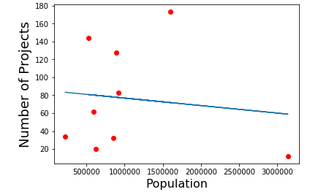
Water Projects and Population Density
Does population influence establishment of the water projects?
Currently,Nairobi has the highest population however it has the least number of water projects established. This depicts that population does not directly influence the number of water projects established

Slide 8
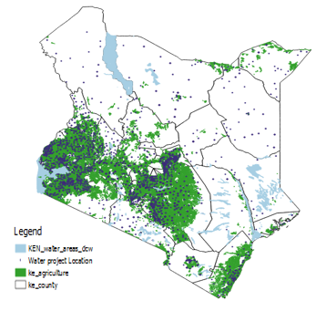
Water Projects and Agriculture
Does agriculture influence the number of water projects per county?
Agriculture influences the water projects establishment, this is depicted by the number of projects established in central , coastal and western regions in the country.
Meru has the highest number of water projects with TharakaNithi and Nairobi having the least

Slide 9
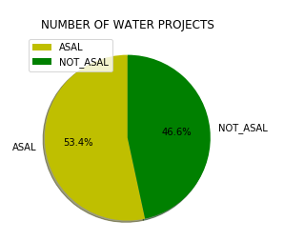
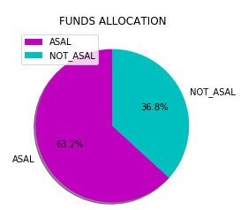
Water Projects and ASAL Classification
Does Arid and Semi land(ASAL) county classification influence the implementation of water projects in Kenya?
Majority of the water projects have been established in counties classified as Arid and Semi Arid lands
On average, more funds have been allocated to water projects in counties classified as Arid and Semi Arid Lands

Slide 10
Findings And Insights
Population should be considered when setting up water projects to improve water access and availability
More funds should be allocated towards the water projects to increase the number of water projects

Slide 11
Limitations and Challenges
Challenges
Inadequate data sets available for data analysis
Null values in the data influence the outcome of the findings
Limitations
The variables analysed did not exhaust all the factors that influence the establishment of water projects in the counties

Slide 12
References
http://devinit.org/wp-content/uploads/2018/12/Enhancing-access-to-safe-water-and-improved-sanitation-services-in-Kenya.pdf
https://files.ihub.co.ke/ihubresearch/uploads/2012/july/1343052795__537.pdf

